Slide 1
Multivariate Time Series Forecasting
Techfest, IIT B

Slide 2
Introduction
This project is inspired by the concept of Multivariate time series forecasting wherein multiple variables will be varying over time.
Each variable depends not only on its past values but also has some dependency on other variables.
This dependency is used for forecasting future values.
In univariate, Only one variable is varying over time.

Slide 3
Project
In this project the dataset consisted of 3915 regions and their business potential for the past 6 years (1-72 month).
I was expected to build a projection of the business potential for each of the 3915 regions for the next 12 to 15 months (72-87 month).
I understood some trends and seasonality in the data for individual regions as well as interdependence of some regions on others due to insights gained from EDA of the given dataset.
Some of statistical time series models along with some classical linear models, tree based algorithms, ensemble methods and sequential neural network based methods like LSTMs and 1d CNNs were used in order to compute the best results as ablations.

Slide 4
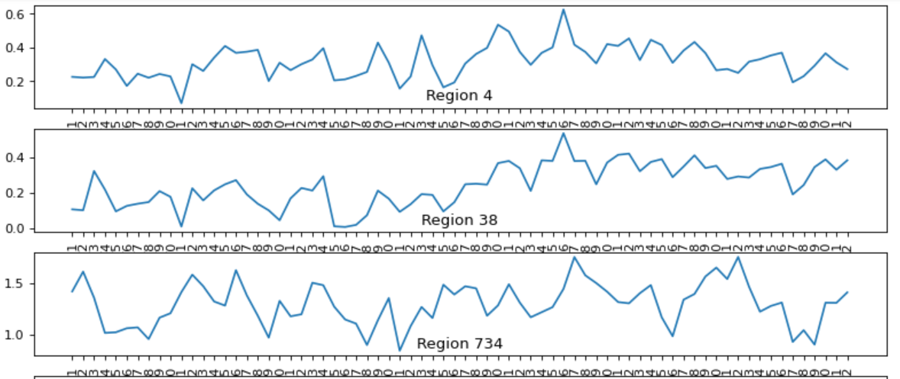
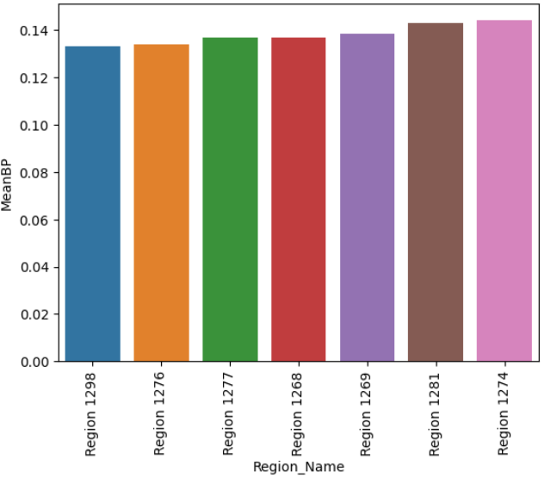
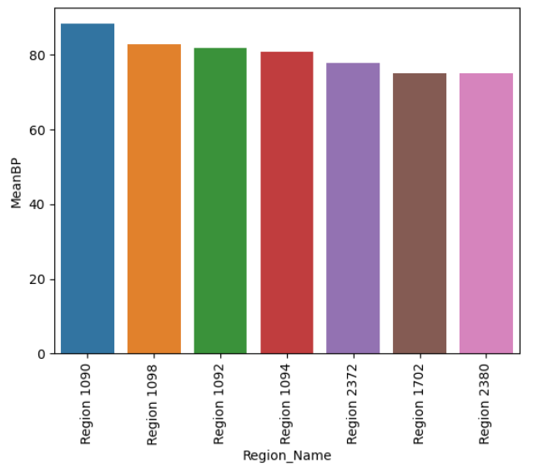
EDA
Region wise progress, usually for most regions peaks from late 50’s to early 60’s months as well as mid 40 months and is the lowest from mid 20 to mid 30 months
Region 1090 has max mean potential followed by 1098,1092 while regions 1277, 1276 and 1298 have least potential

Slide 5
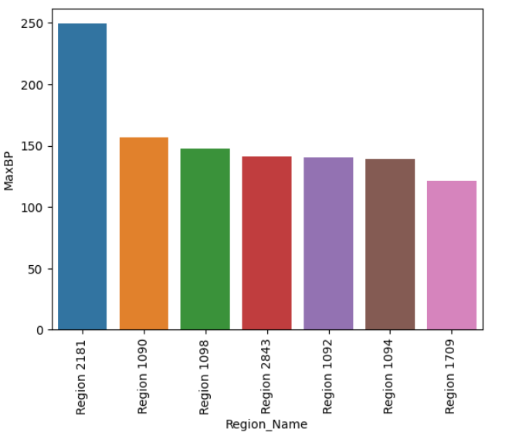
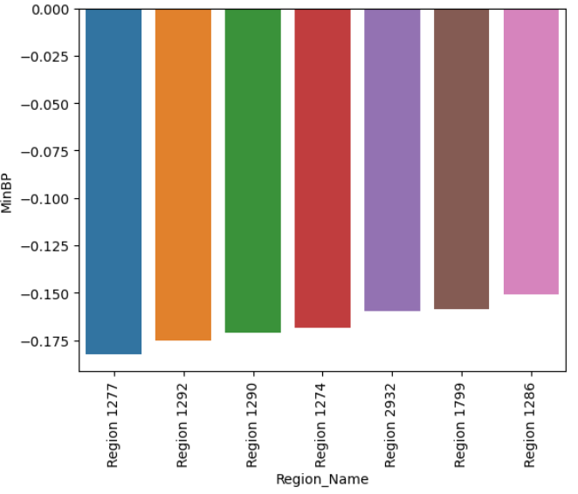
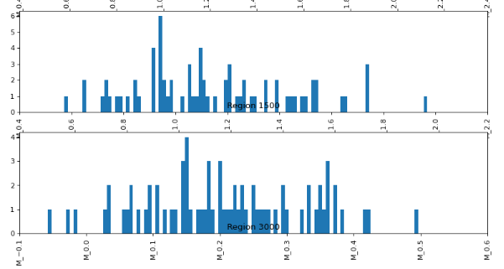
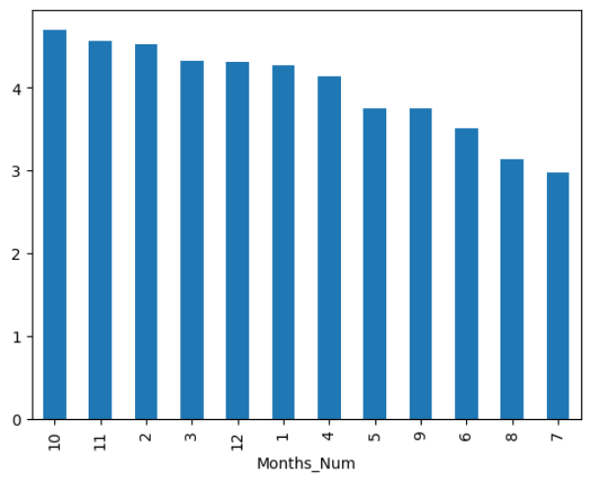
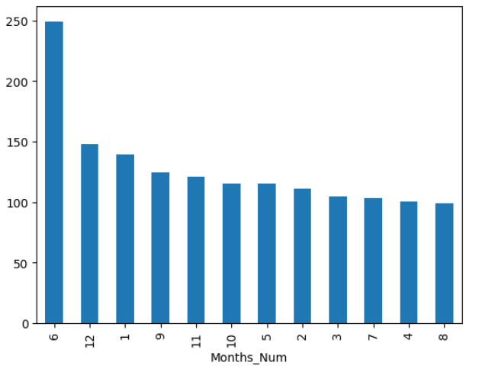
Region 2180 has maximum BP followed by a massive drop by Region 1090, 1098 and Region 2843 in the decreasing order
Region 1277 has minimum BP followed by a rise in BP by Region 1292, 1290 and 1274 in the increasing order.
Histogram variation of BP based upon the distribution
Max mean months of BP is Oct, Nov, Feb
June has maximum BP followed by a massive drop by December, and January in the decreasing order

Slide 6
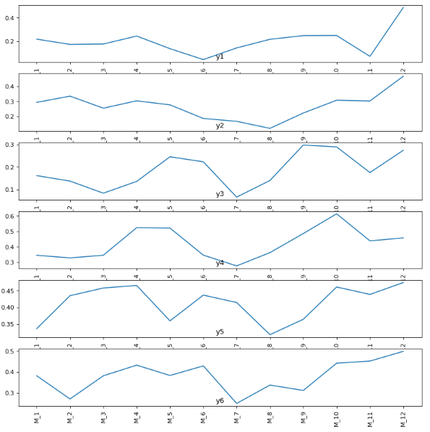
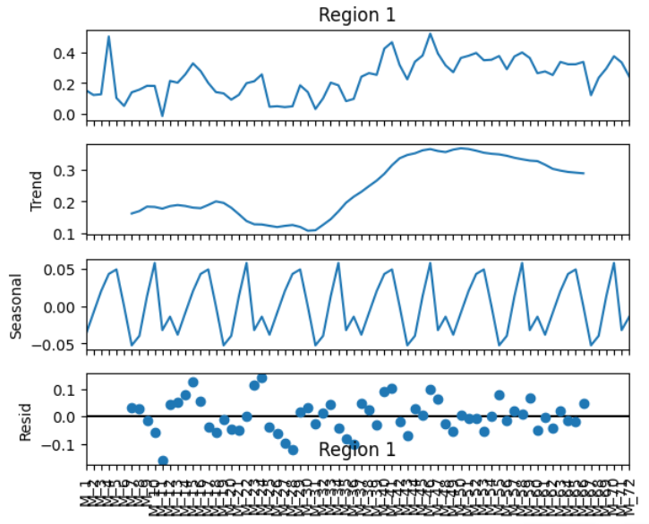
Trend-Seasonality- Residual Decomposition for regions; shows annual seasonality with a slight dip and massive rise trend for a year
Year wise progress for a region

Slide 7
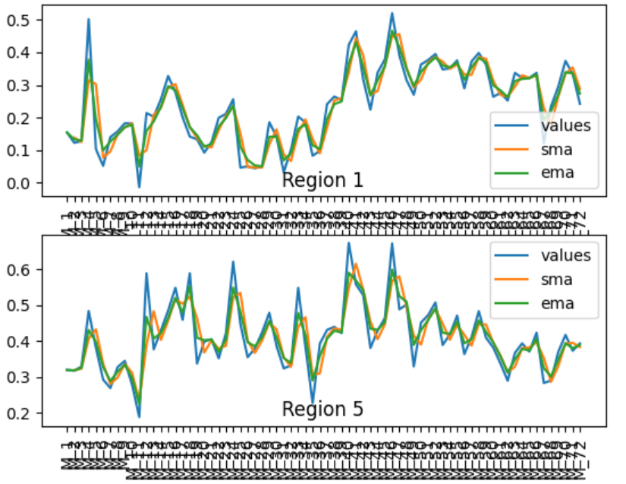
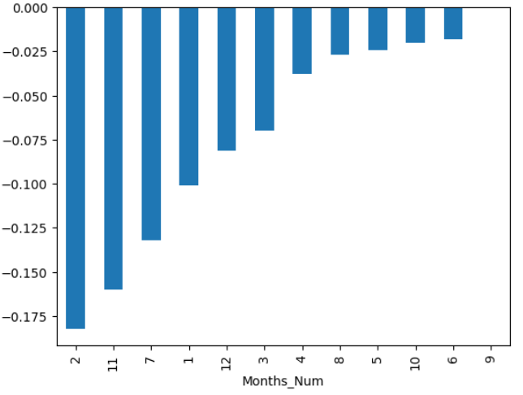
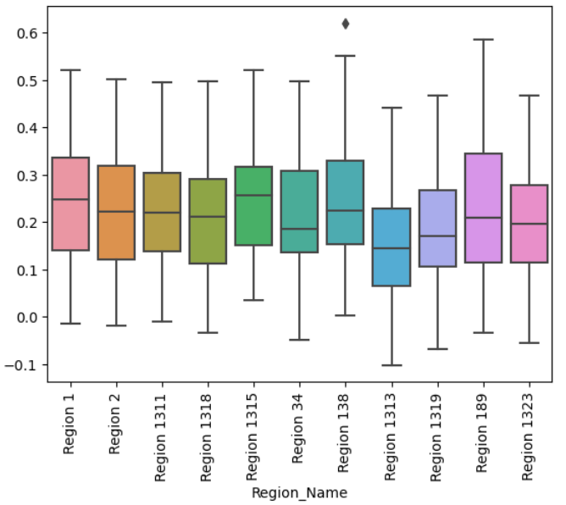
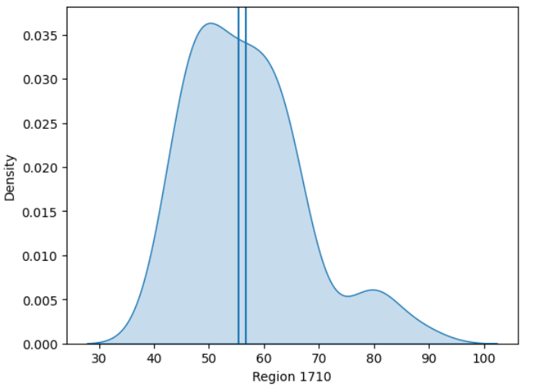
February has Minimum BP followed by November, and July in the increasing order
Variation of regions, SMA and EMA
The value for all regions lies between
-0.19 and 250.
This distribution plot is representative of all regions; no skewness and near normal distributions for all regions
Box plot region wise

Slide 8
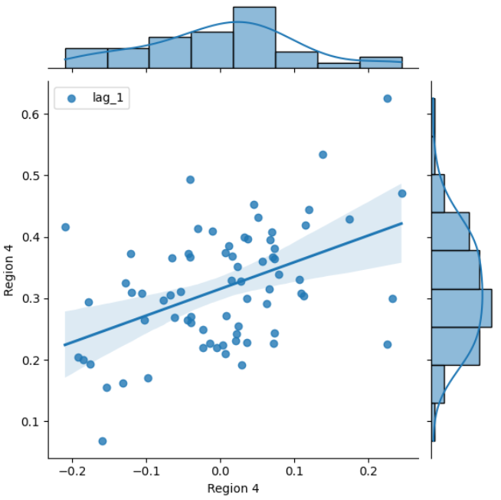
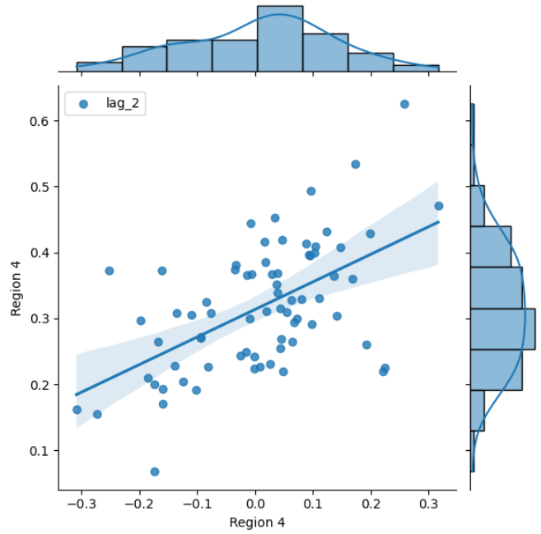
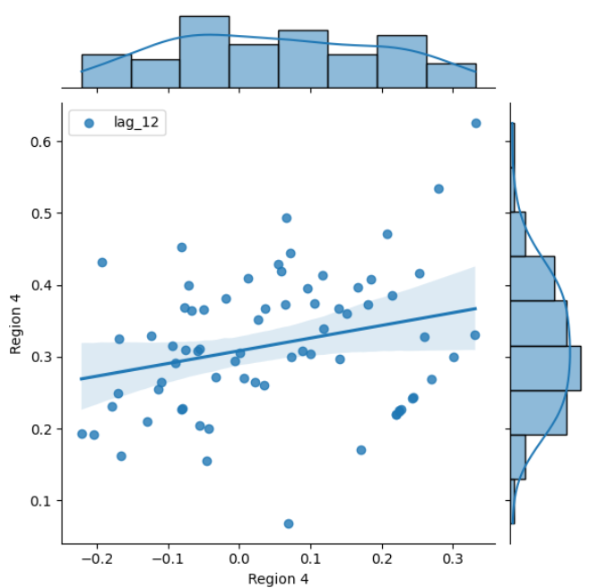
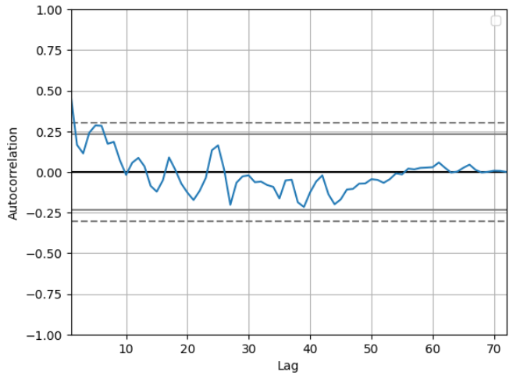
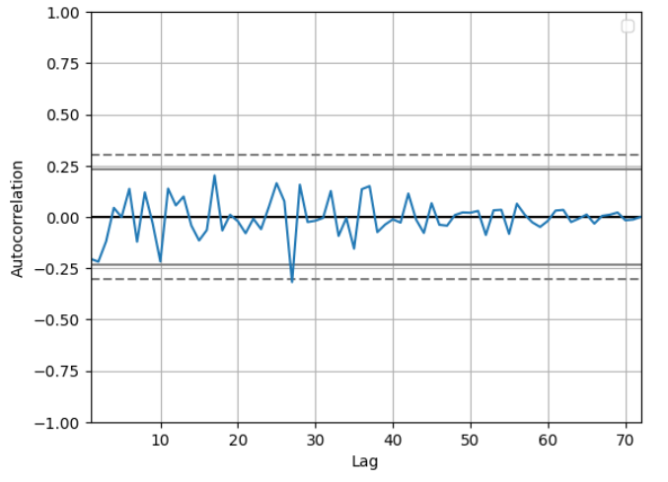
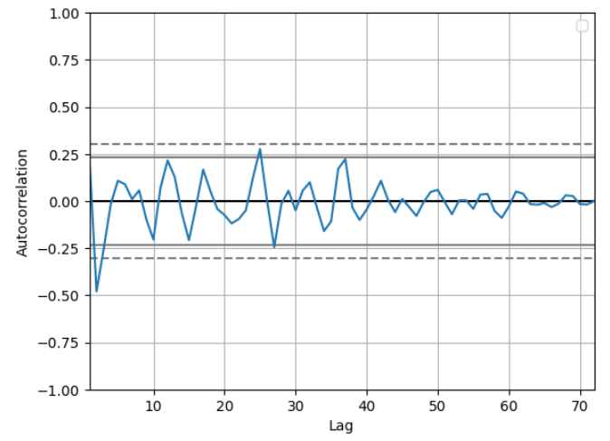
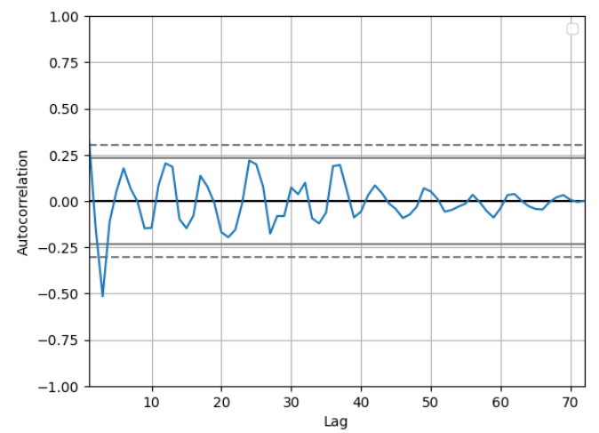
The correlation goes on decreasing as lag number increases for lags in the time series and so best lag value to make the time series stationary is 1.
From stationarity view; lower lag values are better as seen in the autocorrelation plots below.
For lag values 1, 2, and 12 it gets worse as lag value increases and so best lag is 1
No lag for the time series

Slide 9
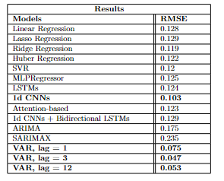
Results and Analysis
From the Results table we can see that the best model is Vector Auto Regression (VAR) Model with takes into consideration the correlation of a Region with respect to other regions with a threshold 0.5 (**).
I have developed VAR solution by only considered the correlated series to form the required dataset.
This is followed by 1d CNNs which use one dimensional CNNs to forecast.
The other univariate time series models preform less efficiently owing to the stationarity issues while the sequential neural networks perform very well on this given time series data followed by ML models.
MinMax Scaler is used which clips the data between 0 and 1.
The dropout probability is 0.3 with max epochs being 50 and batch size is 8.
Rest details can be found in the COLAB notebook provided.

Slide 10
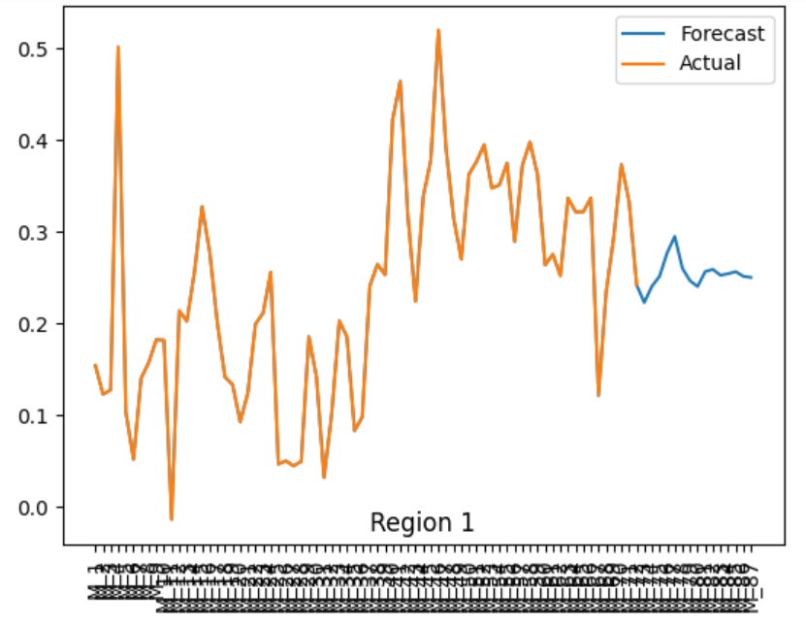
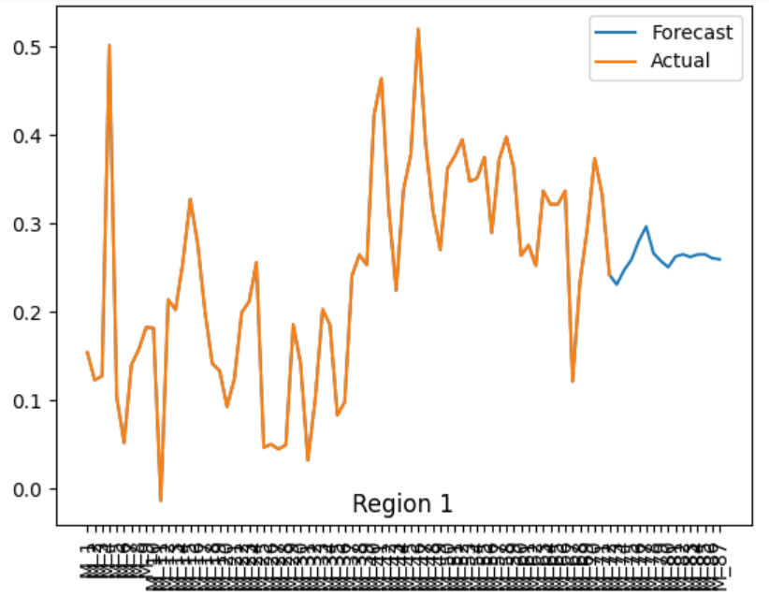
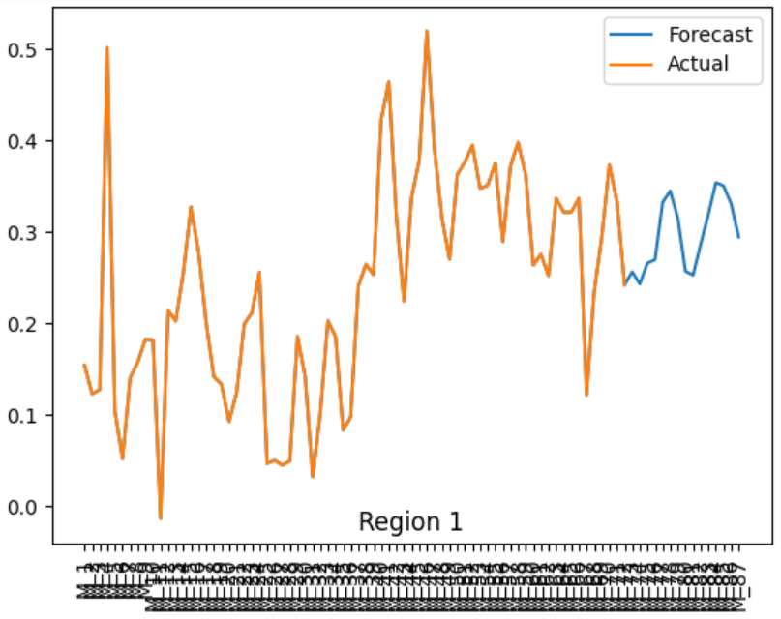
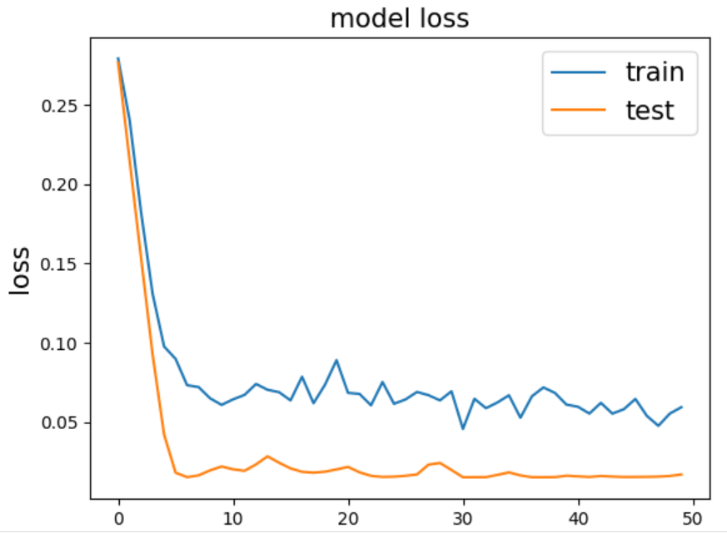
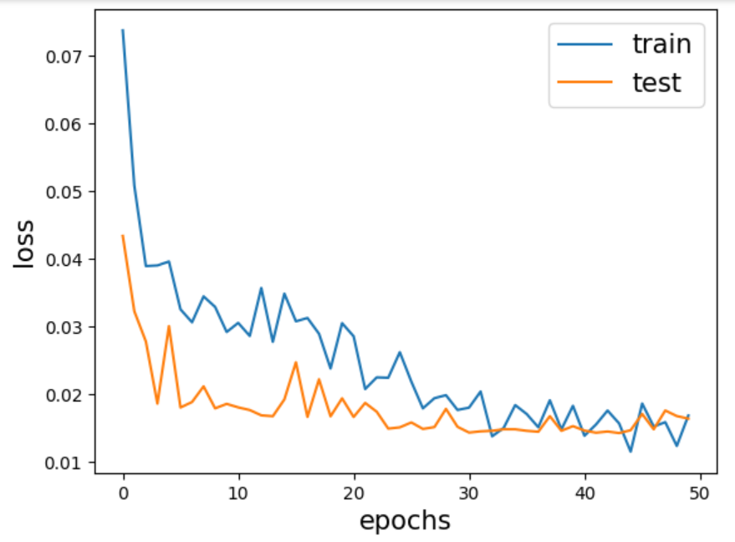
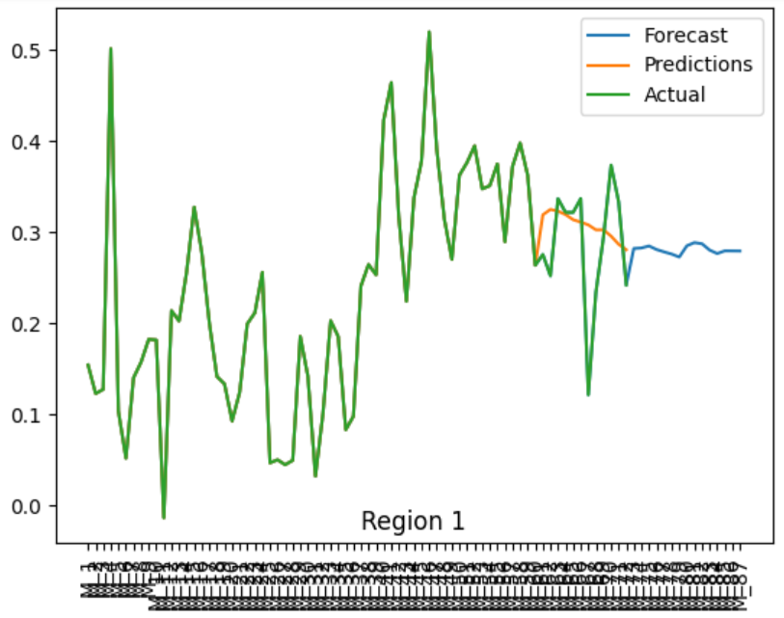
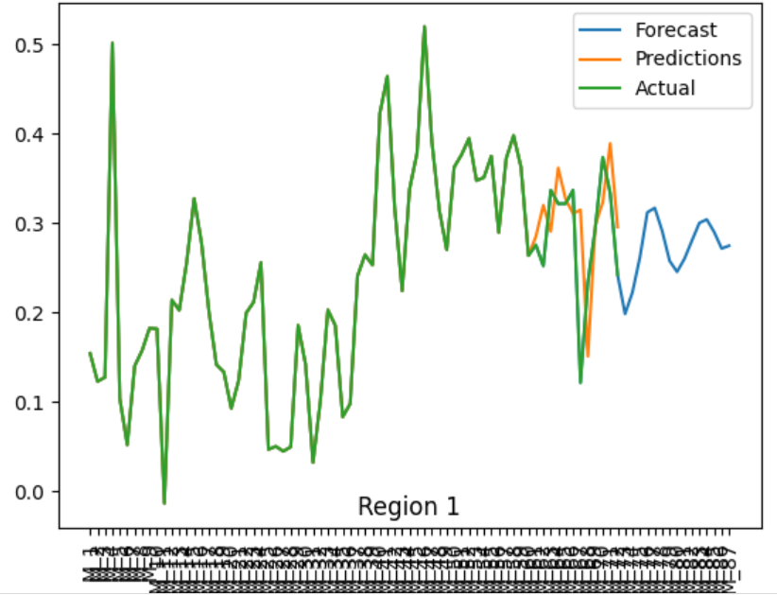
Linear Regression
Ridge Regression
Support Vector Regression
LSTMs
1d CNNs

Slide 11
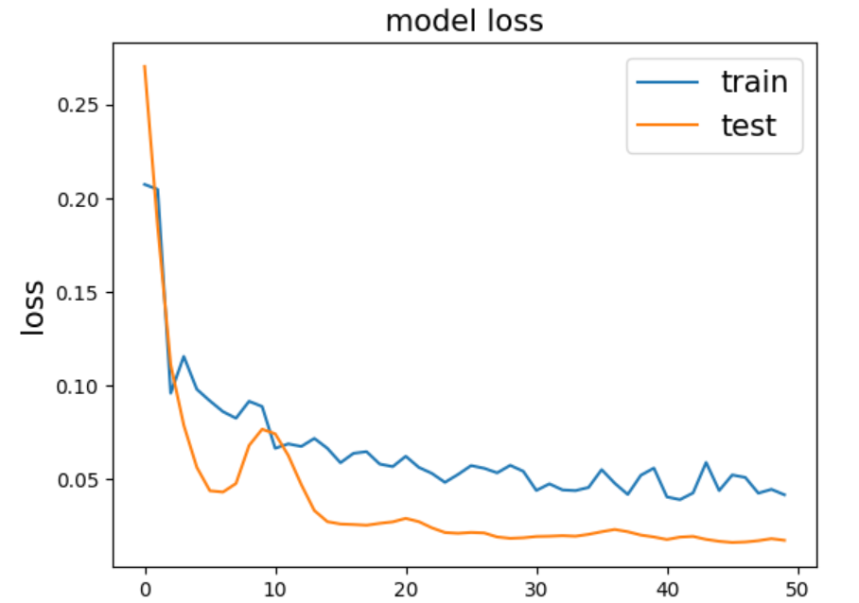
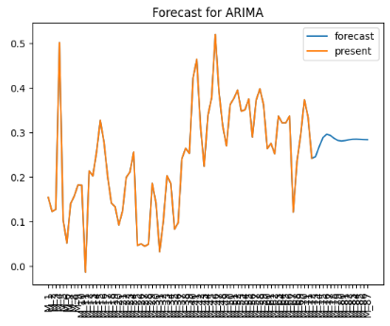
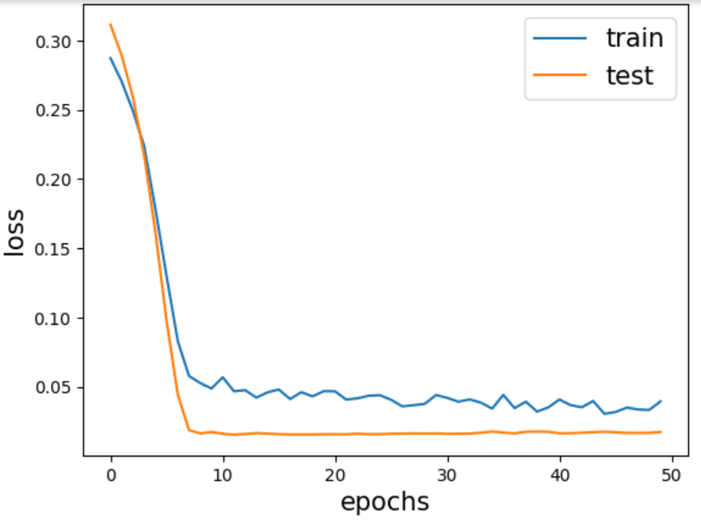
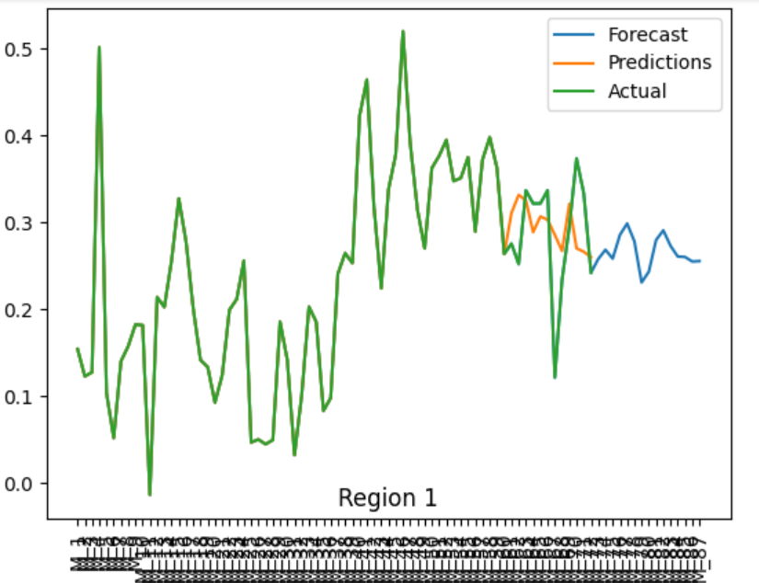
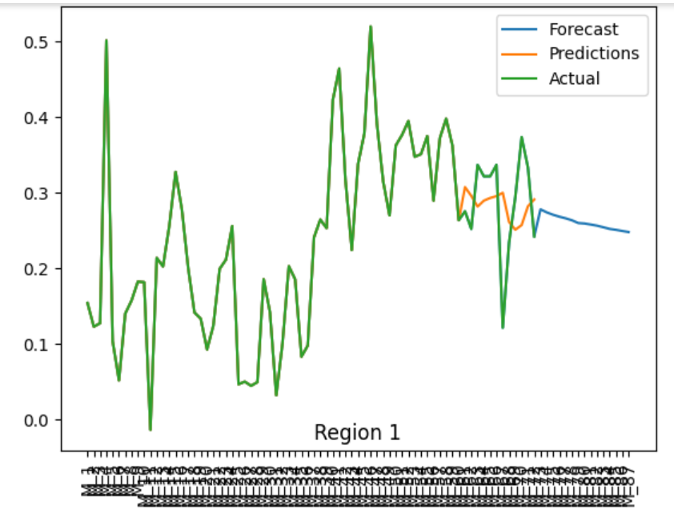
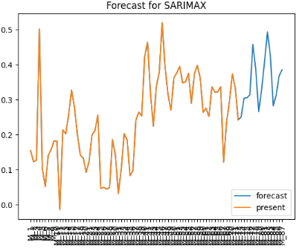
Attention-Based
Bidirectional LSTMs with 1d CNNs
ARIMA
SARIMAX

Slide 12
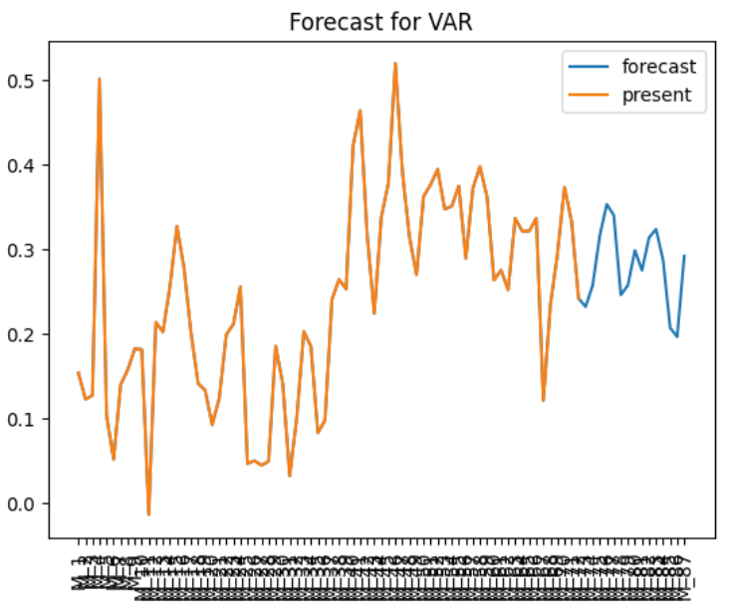
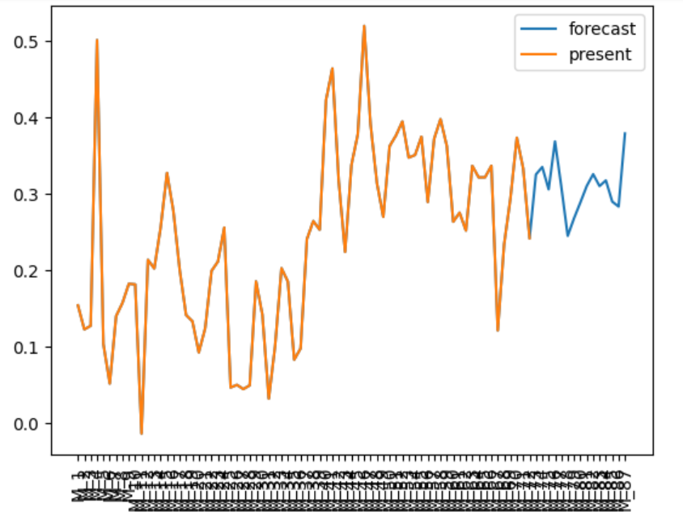
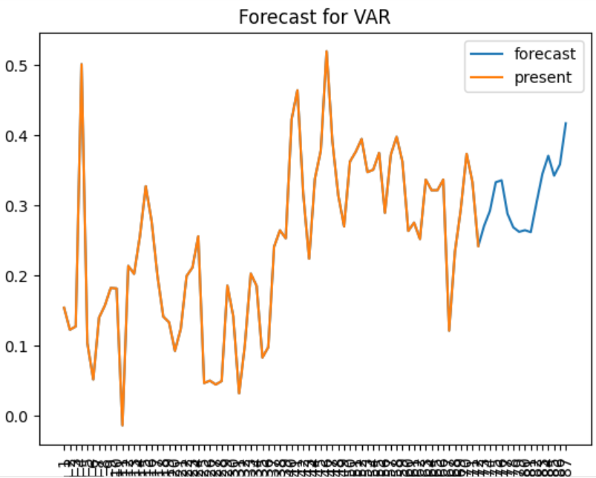
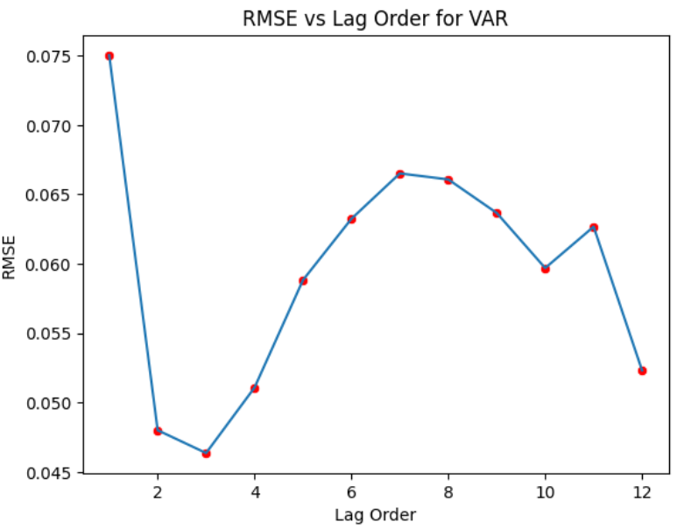
VAR; lag = 12
VAR; lag = 3 * best
VAR; lag = 1 * worst
VAR; RMSE minimum for lag order 3 and maximum for 1 with local maxima at 7

Slide 13
THANK YOU

